Slide 1
JAVA Programming
Course Instructor: Dr. Suvojit Dhara
School of Computer Science
UPES Dehradun

Slide 2
TOPICs to be discussed
Lexical Elements in Java
Types and Literals
Variables
Arrays

Slide 3

Let’s START …!!!

Slide 4
Lexical Elements
Lexical elements in Java are the fundamental components of the code, such as keywords, identifiers, literals, operators, punctuation, and comments.
They are the smallest meaningful units that the compiler recognizes and processes during the compilation of a Java program.

Slide 5
Comments
Within source code we should practice commenting for the convenience of human programmers.
They play no part in the generation of code and so are ignored during scanning.
There are three kinds of comments:
// comment (Characters from // to the end of
the line are ignored)
/* comment */ (All characters between /*
and the next */ are ignored)
/** comment*/ (All characters between /**
and the next */ are ignored)
class Student{
int id; String name; //class fields
/* Class Constructors */
Student(int i, String n){
id = i; name = n;
}
Student(Student s){
id = s.id; name = s.name;
}
/** Class methods */
void display(){
System.out.println(id+" "+name);
}
//main method
public static void main(String args[]){
Student s1 = new Student(111,"Karan");
Student s2 = new Student(s1);
s1.display();
s2.display();
}
}

Slide 6
Identifiers
All Java variables must be identified with unique names. These unique names are called identifiers.
Identifiers can be short names (like x and y) or more descriptive names (age, sum, totalVolume).
Note: It is recommended to use descriptive names in order to create understandable and maintainable code:
// Good
int minutesPerHour = 60;
// OK, but not so easy to understand what m actually is
int m = 60;

Slide 7
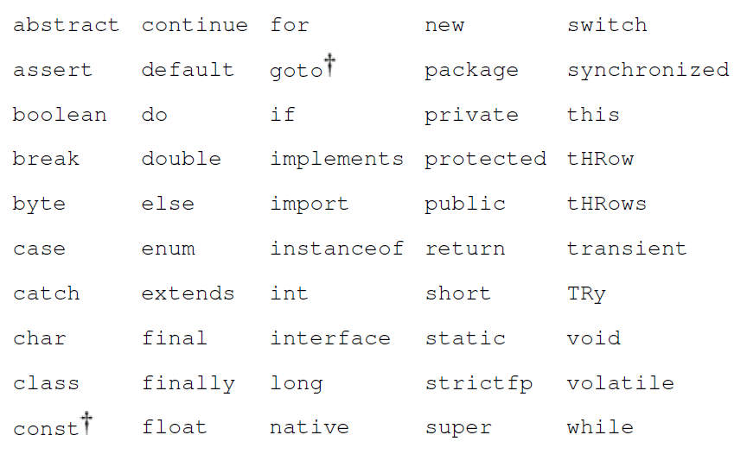
Keywords
Language keywords cannot be used as identifiers because they have special meaning within the language.
Keywords “goto” and “const” are reserved but currently unused.

Slide 8
Data Types
The primitive data types are:
boolean either true or false
char 16-bit Unicode UTF-16 code unit (unsigned)
byte 8-bit signed two's-complement integer
short 16-bit signed two's-complement integer
int 32-bit signed two's-complement integer
long 64-bit signed two's-complement integer
float 32-bit IEEE 754 floating-point number
double 64-bit IEEE 754 floating-point number
Each primitive data type has a corresponding class type in the java.lang package. These wrapper classes Boolean, Character, Byte, Short, Integer, Long, Float, and Double also define useful constants and methods.

Slide 9
Literals
Boolean Literals
The boolean literals are true and false.
public class A {
public static void main(String[] args) {
char _char = '\n';
System.out.println("Good"+_char+
"morning");
}
}
Output: Good
morning
Character Literals
Character literals appear with single quotes: ‘Q’. Any valid Unicode character can appear between the quotes.
Certain special characters can be represented by an escape sequence:
\n newline
\t tab
\b whitespace
\r return
public class A {
public static void main(String[] args) {
char _char = '\b';
System.out.println("Good"+_char+
"morning");
}
}
Output: Good morning

Slide 10
Literals (Contd..)
Integer Literals
Integer literals are strings of octal, decimal, or hexadecimal digits. The start of a literal declares the number’s base: A 0 (zero) starts an octal number (base 8); a 0x or 0X starts a hexadecimal number (base 16); and any other digit starts a decimal number (base 10). All the following numbers have the same value:
29 035 0x1D 0X1d
Integer constants are long if they end in L or l, such as 29L;
Floating-Point Literals
Floating-point literals are expressed in either decimal or hexadecimal form. The decimal form consists of a string of decimal digits with an optional decimal point, optionally followed by an exponent the letter e or E, followed by an optionally signed integer. At least one digit must be present. All these literals denote the same floating-point number:
18. 1.8e1 .18E+2 180.0e-1

Slide 11
Literals (Contd..)
The hexadecimal form consists of 0x (or 0X), a string of hexadecimal digits with an optional hexadecimal point, followed by a mandatory binary exponent the letter p or P, followed by an optionally signed integer. The binary exponent represents scaling by two raised to a power. All these literals also denote the same floating-point number (decimal 18.0):
0x12p0 = 0x12 (18) * 2^0 = 18.0
0x1.2p4 = 0x1.2 * 2^4 = 1.125 * 2^4 = 18.0
0x.12P+8 = 0x.12 * 2^8 = (9/128) * 2^8 = 18.0
0x120p-4 = 0x120 * 2^-4 = 288 * 2^-4 = 18.0
Floating-point constants are of type double unless they are specified with a trailing f or F, which makes them float constants, such as 18.0f. A trailing d or D specifies a double constant.

Slide 12
Literals (Contd..)
String Literals
String literals appear with double quotes: “along”. Any character can be included in string literals, except for newline and “ (double quote).
Newlines are not allowed in the middle of strings. If you want to embed a newline character in the string, use the escape sequence \n. To embed a double quote use the escape sequence \”.
A string literal references an object of type String.
public class A {
public static void main(String[] args) {
String str1 = "Good";
String str2 = "Morning";
char _char = '\n';
System.out.println(str1+_char+str2);
}
}
Output: Good
morning

Slide 13
Variables
A variable is a storage location that can hold a value to which a value can be assigned.
A variable declaration is broken into three parts: modifiers, followed by a type, followed by a list of identifiers.
float x, y; is same as float x;
float y;
float x = 3.14f, y = 2.81f; is same as float x = 3.14f;
float y = 2.81f;

Slide 14
Variables (Contd..)
Field variables are members of classes, or interfaces, and are declared within the body of that class or interface. Fields have a lifetime that is tied to the lifetime of the object (instance) of the class they belong to. They exist as long as the object they are a part of is in memory.
Local variables, on the other hand, are declared within methods and have a limited scope. They can only be accessed within the method in which they are declared.
Parameter Variables are the parameters declared in methods, constructors, or catch block. A parameter declaration consists of an optional modifier, a type name, and an identifier.
final Variables: Final modifier declares that the value of the variable is set exactly once and will thereafter always have the same value. Any variable fields, local variables, or parameters can be declared final. Variables that are final must be initialized before they are used.
final float pi = 3.141f;

Slide 15
Array
An array is a data structure that allows you to store a fixed-size collection of elements of the same data type. Arrays provide a way to group related data under a single variable name.
Each element in an array can be accessed using an index, which indicates its position in the array.
The general form of declaring an array of any type is as follows:
type[] name = new type[length];

Slide 16
Array (Contd..)
When an array is created, each element is set to the default initial value for its type, zero for the numeric types, ‘\u0000’ for char, false for boolean, and null for reference types.
When you initialize an array within its declaration, you don't have to explicitly create the array using new, it is done implicitly for you by the system.
The length of the array to create is determined by the number of initialization values given.
The following code gives the same result:
String[] dangers = {"Lions", "Tigers", "Bears"};
String[] dangers = new String[3];
dangers[0] = "Lions"; dangers[1] = "Tigers"; dangers[2] = "Bears";
String[] dangers = new String[]{"Lions", "Tigers", "Bears"};

Slide 17
Array (Contd..)
class _array {
public static void main(String[] args) {
int[] a = new int[5];
a[0]=1;
a[1]=2;
a[2]=3;
a[3]=4;
a[4]=5;
for(int i=0; i<=4; i++)
System.out.println(a[i]);
}
}
class _array {
public static void main(String[] args) {
int a[] = {1, 2, 3, 4, 5};
for(int i=0; i<=4; i++)
System.out.println(a[i]); }
}
class _array {
public static void main(String[] args) {
int a[] = {1, 2, 3, 4, 5};
for(int i=0; i<a.length; i++)
System.out.println(a[i]); }
}
class _array {
public static void main(String[] args) {
int[] a = {1, 2, 3, 4, 5};
for(int i=0; i<=4; i++)
System.out.println(a[i]); }
}
Output: 1
2
3
4
5

Slide 18
Array of Arrays (2D/3D)
class _array {
public static void main(String[] args) {
int[][] a = new int[3][2];
a[0][0]=1;
a[0][1]=2;
a[1][0]=3;
a[1][1]=4;
a[2][0]=5;
a[2][1]=6;
for(int i=0; i<2; i++) {
for(int j=0; j<2; j++)
System.out.print(a[i][j]+ " ");
System.out.print('\n');
}
}
}
Output: 1 2
3 4
5 6

Slide 19
Summary
Today, we learned about
Lexical elements in Java (Comments, Identifiers, Keywords)
Types and Literals (Boolean, Character, Integer, Floating-point, String)
Variables
Arrays
Array of Arrays

Slide 20


